Slide 1
SUPER TDMA How does it go up against Traditional TDMA ?

Slide 2
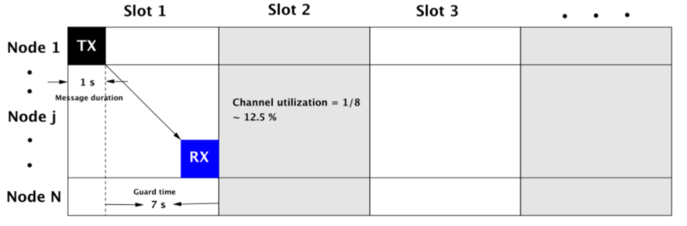
Problem with Traditional-TDMA for U-Nets
Under-utilised channels due to large propagation delays, leading to poor throughputs.
Example:
Node Distance: 10 km
Message Duration: 1 s
Propagation Delay: 7 s

Slide 3
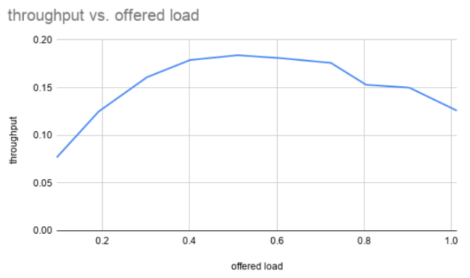
The Result ?
( Simulation Results of the old TDMA script )
Poor Throughput…..

Slide 4
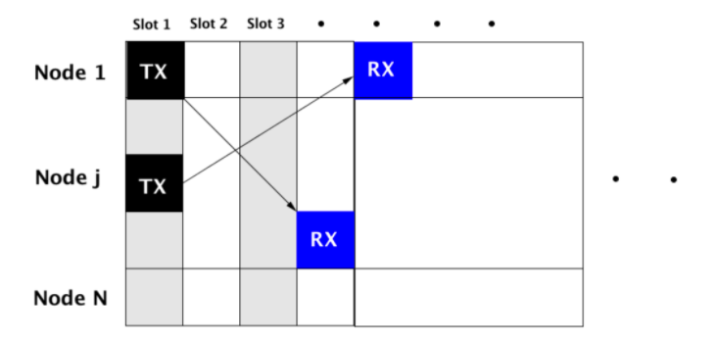
How does Super TDMA improve on this ?
Super TDMA exploits the large propagation delays we face underwater.
The key idea is to schedule a message to be transmitted in one slot and receive it in a different slot.

Slide 5
What does this result in ?
Much better channel utilization as seen in the figure below.
Eliminating the requirement of guard times for propagation delays results in much higher throughputs.

Slide 6
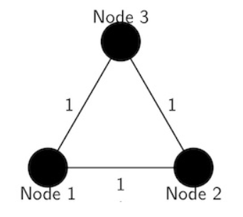
Example Network
Three Nodes, equidistant to each other, forming an equilateral triangle.
The amount of time taken for a message to reach from any one node to another node will be the same.

Slide 7
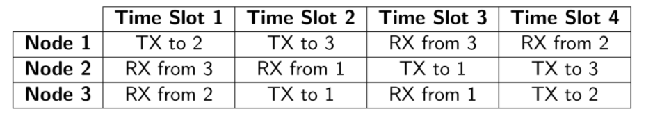
Schedule Visualization
Since we are splitting the transmissions and receptions, we need to carefully schedule them in different slots.
This is the exact principle we use in algorithms for more complex network geometries.

Slide 8

What’s so ”SUPER” about Super-TDMA

Slide 9
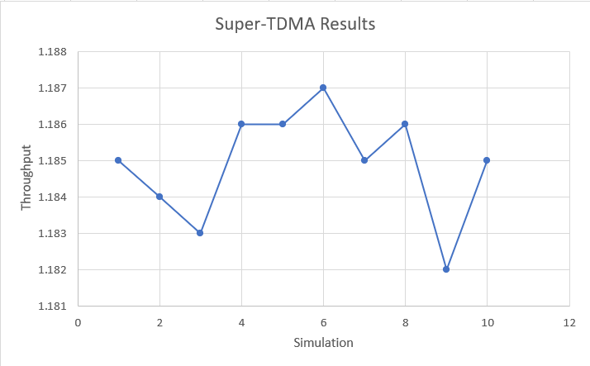
Simulation Results
( Simulation Results of the Super-TDMA script )
Indeed Super…..

Slide 10
Traditional TDMA Results
( Simulation Results of the old TDMA script )
Just to reiterate…..

Slide 11
Challenges with Super TDMA
With shorter time slots, very accurate time syncronization is required between the nodes. Frequent clock information exchange is needed.
This leads to requirement of both, hardware and software, that can handle frequent transitions between different types of data shared.
The time slot lengths and guard interval calculation need to be very carefully done to maximise slot efficiency.

Slide 12
And Most Importantly……
Random network topologies and mobile nodes
The example earlier was a special network geometry where all the network nodes were static and equidistant to each other.
In practice, this is of course not the case. We may have random network topologies and even mobile nodes in the network.
Computing schedules for such practical networks utilizing what we have learned from this special network is an active field of research.

Slide 13
A few Research Papers on the Topic
M. Chitre, M. Motani, and S. Shahabudeen, “Throughput of networks with large propagation delays,” IEEE Journal of Oceanic Engineering, vol. 37, no. 4, pp. 645–658, 2012.
P. Anjangi and M. Chitre, “Experimental Demonstration of Super-TDMA: A MAC Protocol Exploiting Large Propagation Delays in Underwater Acoustic Networks,” in Underwater Communications Networking (Ucomms 2016), (Lerici, Italy), September 2016.
P. Anjangi and M. Chitre, “Design and Implementation of Super-TDMA: A MAC Protocol Exploiting Large Propagation Delays for Underwater Acoustic Networks,” in WUWNet’15, (Washington DC, USA), October 2015.
Noh, P. Wang, U. Lee, D. Torres, and M. Gerla, “DOTS: A propagation delay-aware opportunistic MAC protocol for underwater sensor networks,” inProc. 18th IEEE Int. Conf. Network Protocols, 2010, pp. 183–192.
P. Anjangi and M. Chitre, “Propagation-Delay-Aware Unslotted Schedules with Variable Packet Duration for Underwater Acoustic Networks,” IEEE Journal of Oceanic Engineering, vol. 42, no. 4, pp. 977–993, 2017.

Slide 14
Thank You !

